Slide 1
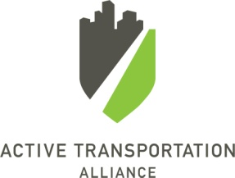
Building a New Rider Advocacy Group for Chicago’s “Legacy” Transit System
Center for Transportation Excellence Webinar April 10, 2012
Jennifer Henry
Natural Resources Defense Council
Brenna Conway
Active Transportation Alliance

Slide 2
History and context
Launch
Progress and lessons thus far
What’s next

Slide 3
History and context
Launch
Progress and lessons thus far
What’s next

Slide 4
History and context
NRDC and Active Trans interest, resources
State of transit infrastructure in the region
Scoping:
Past campaigns/organizations
Current landscape of advocacy organizations
Examples in other cities

Slide 5
History and context
Launch
Progress and lessons thus far
What’s next

Slide 6
Prep for Launch
Hired Brenna!
Quiet introductions and development of advocacy platform:
Met with transit agencies, other agencies
Held individual and group meeting w advocates
>> Defined objective and advocacy platform!
>> Official launch Aug 24, 2011

Slide 7
Website…

Slide 8
Survey…

Slide 9
Objective
Organize transit riders in the Chicagoland region to ensure their transportation needs are met with better transit options.
Riders for Better Transit will work to:
Increase transit funding
Support projects that benefit your community
Create a community of transit riders

Slide 10
Advocacy platform
Our region deserves a world class transit system
Bring Bus Rapid Transit (BRT) to Chicagoland
Complete modernization of CTA’s Red Line
Modernize Union Station
Our transit system needs investment
Flex state motor fuel funds for transit
Increase the state motor fuel tax with a portion devoted to transit
Flex federal transportation dollars for transit
Fund transit in tollway corridors with a portion of tolls
Our transit system should be responsive to riders’ needs
Create a universal fare system now
Provide real-time transit information
“Complete stations”

Slide 11
Facebook…

Slide 12
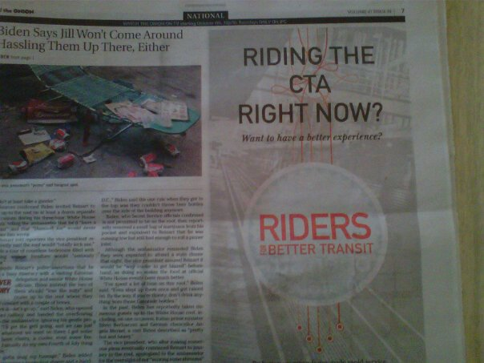
Outreach for launch and survey
Outreach
81,700 recipients on various (overlapping) email lists
4,800 followers on various allies’ FB pages
Press release and outreach
Flyers at stations (8 stations covered)
Onion ad
Results:
Initial survey responses: about 1650 complete
Press hits in major papers
Email sign-ups: 1015

Slide 13
History and context
Launch
Progress and lessons thus far
What’s next

Slide 14
Action Alerts
Topics:
Transit agency budgets: 3000 messages generated
Cook County’s threat to cut funding: 1000 (15% response rate)
Federal commute benefit cut for transit: 900
Federal House bill (HR 7): 700 (10%)
Transit Fast Forward (our state bill): 1800 (3%)
Distribution:
Email
Facebook, Twitter
Flyers
Blogs
Community presentations, partner organizations

Slide 15
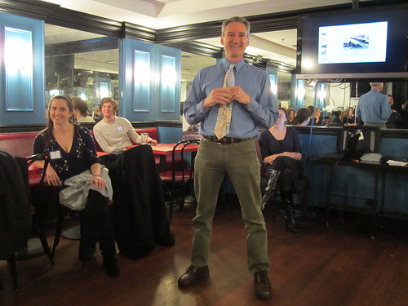
Socials and “Days of Action”

Slide 16
Expanding our grassroots outreach
Neighborhood/community organizations
Seek partner organizations that represent high levels of transit ridership; affordable housing, student groups, etc.
Meet groups where they are
Suburban
Identify targets
Use existing coordinators, but focus on transit
Aldermanic outreach
Direct contact with daily transit riders

Slide 17
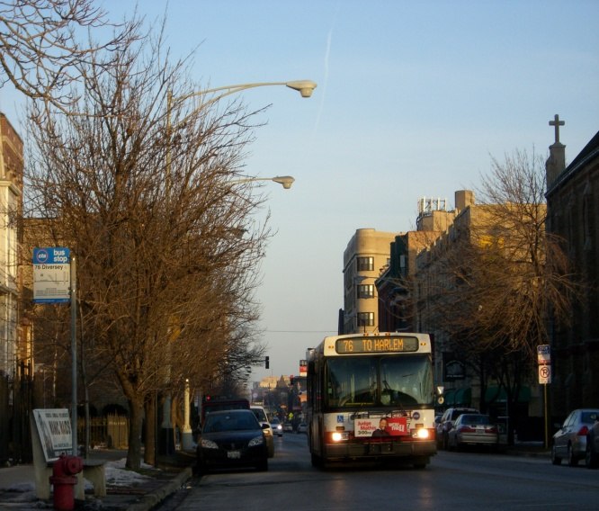
Example: Bus Rapid Transit Outreach
Define a specific area or corridor
Aldermanic outreach
26 affected wards, 12 aldermen
Identify groups with a possible stake in the project
Presentations to businesses, residents, commuters, possible opposition to the project
Direct outreach to transit riders
Flyers at train/bus stops

Slide 18
History and context
Launch
Progress and lessons thus far
What’s next

Slide 19
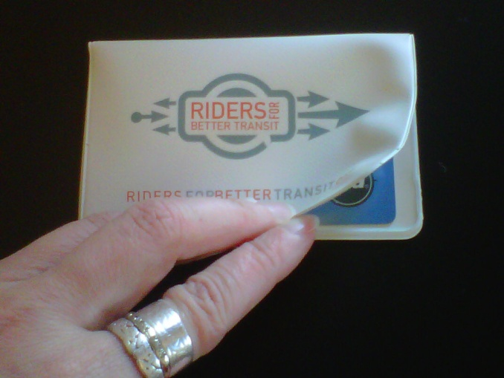
What’s next…
Continue with our basic tactics (and fundraise)
Additional tactics we’re considering:
Advertising
Waiting for the next crisis
Influence state budget
Produce a report on problems and solutions
Petition to the Governor
Develop our identity as a source of the most relevant info (blogging, speaker series, etc.)

Slide 20
Conclusion
(Not very surprising) lessons we’d pass on:
First hit, with the survey, was the biggest (we’re now just over 2000).
Dedicated staff is key; ideas are easy, follow-through is hard.
The policy solutions aren’t easy…
Funding is what we need but hardly a crowd-pleaser.
We don’t like crises, but they do help build support.
(Also unsurprising) lessons we’re hoping to be able to confirm:
Build a strong (if small) base that is aligned w your mission, and don’t forget them.
Laying the groundwork of relationships and research pays off.
It’s possible to keep growing steadily even with a limited budget.

Slide 21
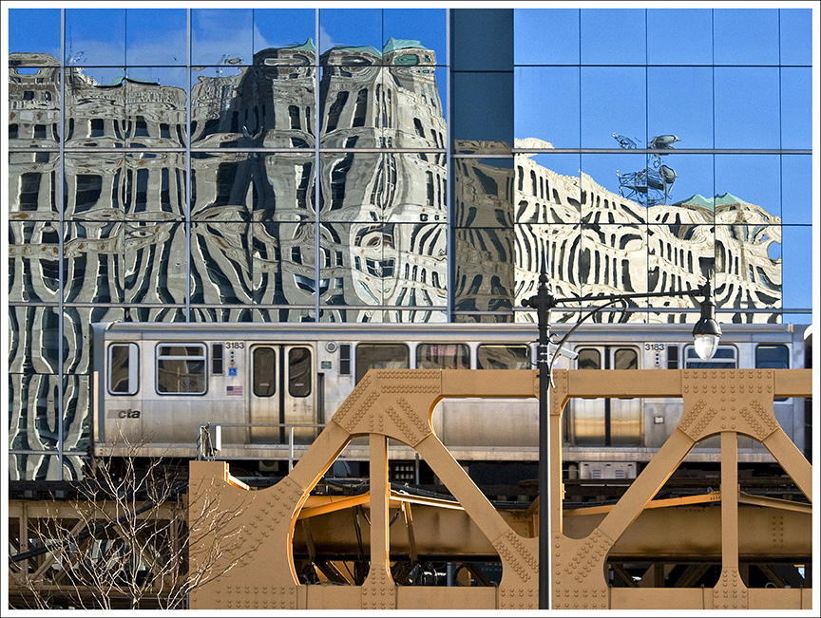
Thanks for listening! And good luck in your own efforts!
www.RidersForBetterTransit.org
www.facebook.com/RidersForBetterTransit
Jennifer Henry
Natural Resources Defense Council
jhenry@nrdc.org
312.651.7912
Brenna Conway
Active Transportation Alliance
brenna@activetrans.org
312.427.3325 x392

