Slide 1

Six Stops to Success:
Public Transportation Research
May 13, 2014
Washington, DC

Slide 2
Housekeeping
Webinar and presentation available at www.cfte.org/six-stops
Questions box

Slide 3
Today’s Speakers
Darnell Grisby, Director, Policy Development and Research, American Public Transportation Association
Jennifer Kalczuk, External Relations Manager, The Rapid and Chair, Marketing and Communications Committee, American Public Transportation Association
Mantill Williams, Director, Advocacy Communications, American Public Transportation Association

Slide 4
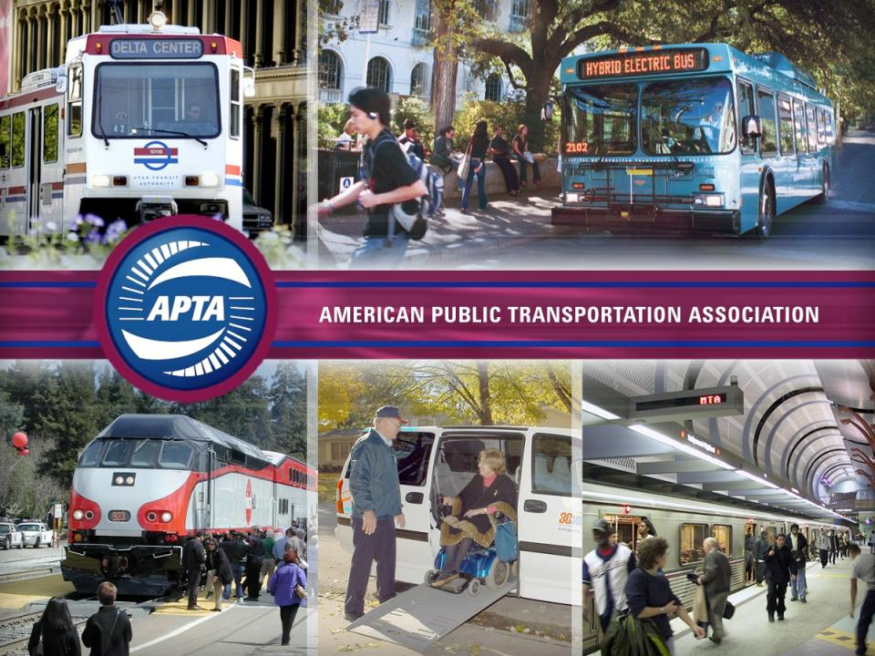
Notes:
Hi, my name is Darnell Grisby, and I am Director of Policy Development and Research for APTA. Today I will illustrate some ways that research can supplement your education and organizing efforts. Our research program focuses on the economic and community development impacts of public transportation, and there is a great story to tell.

Slide 5
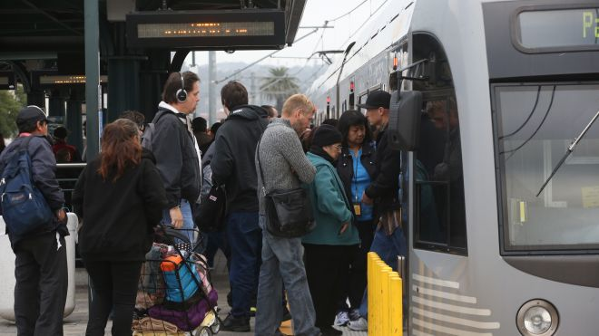
Record Public Transit Ridership
Notes:
Last year, public transportation ridership hit record levels, in fact, the highest levels since 1956. A number of factors contributed to this, and our research will give you the tools to say why and why this is relevant to your community.
I will first showcase some of the changes in the US economy in recent years, illustrate how communities are creating wealth in this new context and will then identify how demographic trends make this the proper time to invest in public transportation. I will show how public transportation can protect your on-going efforts to attract companies and convention business. I will close by showing some examples of how others around the nation have used our research in their organizing efforts.

Slide 6
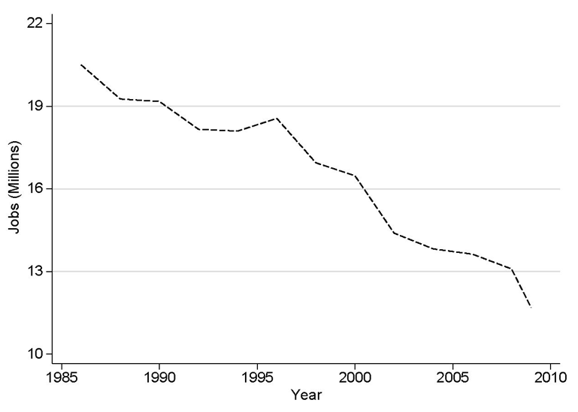
Decline In Manufacturing Jobs
Notes:
As you can see, there has been a precipitous decline in manufacturing jobs in the US. This figure includes the recent success in some regions of the US as well as the budding craft manufacturing movement taking place in cities around the nation.

Slide 7
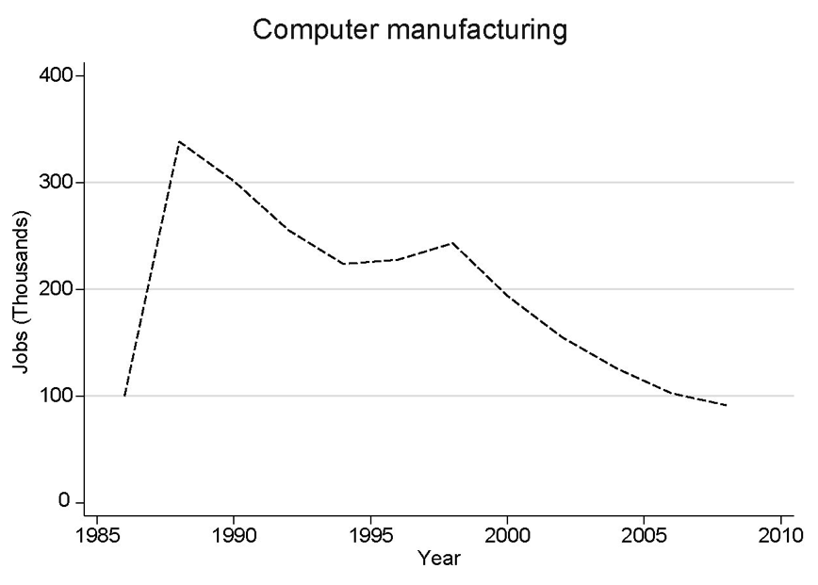
Computer Manufacturing
Notes:
Computer manufacturing is also down

Slide 8
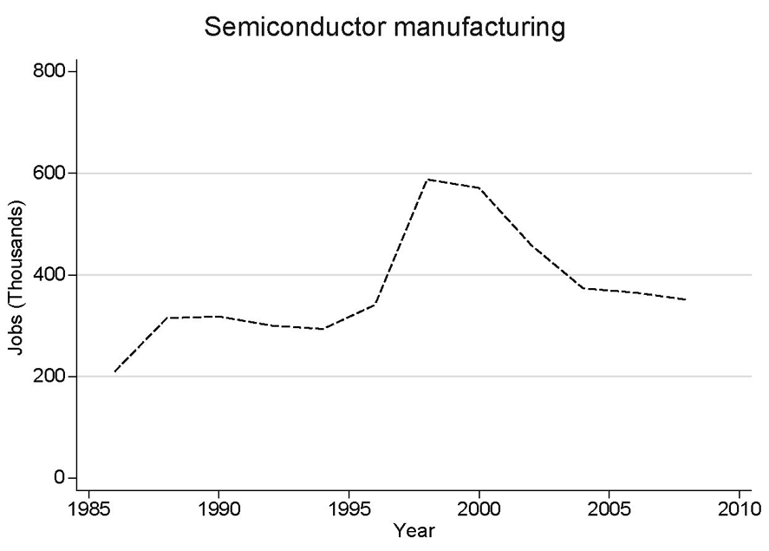
Semiconductor Manufacturing
Notes:
As is semiconductor manufacturing

Slide 9
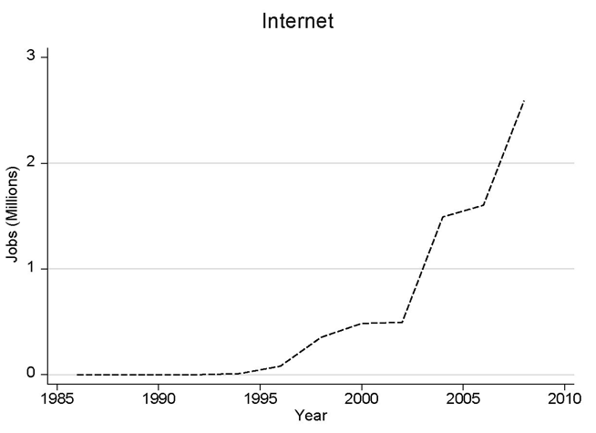
Growth In Internet Jobs
Notes:
However, growth in internet jobs is very robust

Slide 10
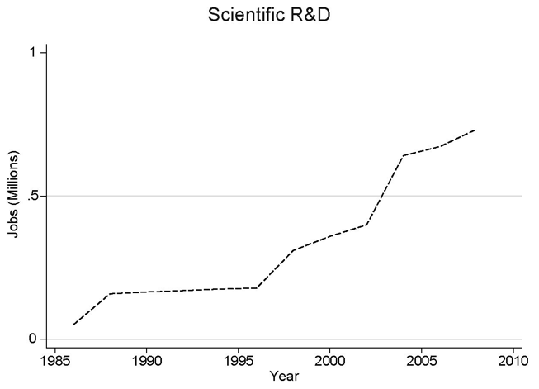
Scientific R&D Jobs
Notes:
Scientific research and development jobs are also growing.

Slide 11
Software Jobs
Notes:
…as well as software jobs…

Slide 12
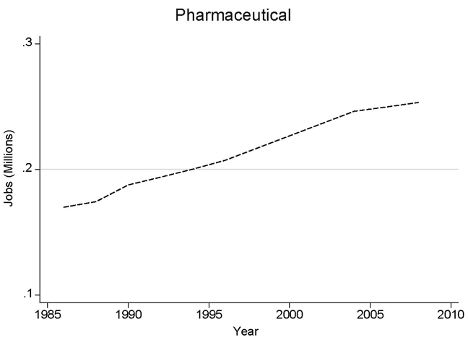
Pharmaceutical Jobs
Notes:
…and pharmaceutical jobs

Slide 13
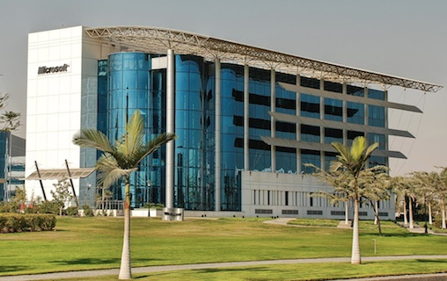
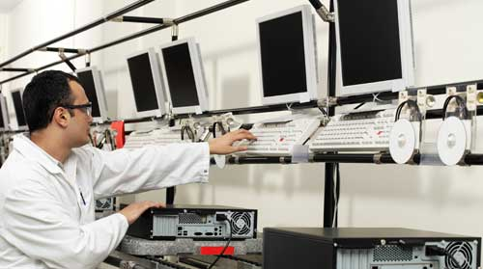
New Job Creation Paradigm
Notes:
These jobs in the new economy need public transportation, far more than industries in previous eras. As this shift in our economy continues, we are also seeing a shift in business location strategies. Employers are looking for areas that have the talent that they need. When they find talent, they tend to cluster together. As a result, they are creating more opportunities for everyone in that economy, whether they work in high-tech or not. Increasingly, there is evidence, that the workers that these employers are chasing, prefer communities with a variety of travel options. That puts you and your efforts in the driver’s seat in your community.

Slide 14
New Job Creation Paradigm
Notes:
This nexus between workforce retention and attraction, and economic development is key. The ability of a community to be attractive to the workers that these companies need, and by extension, the ability to attract the companies you need for job growth, rests on your ability to build an attractive mobility system.

Slide 15
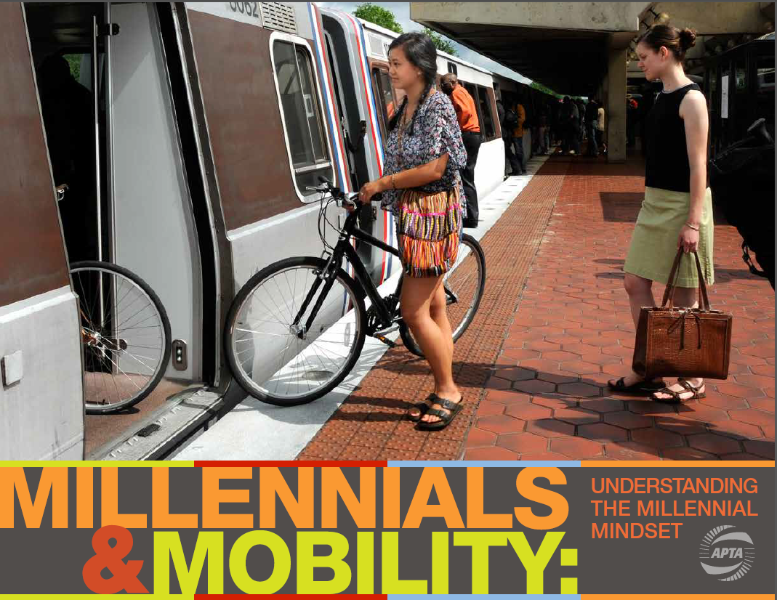
Notes:
The Millennial Generation, those born between 1982 and 2003, is driving much of this trend. There are over 70 million of them and they are choosing a select number of places to settle, and companies are following them. In fact, the data are clear, they have a preference for places that offer mobility choices that include the car, but goes beyond it as well.
Given the historic context, the economic conditions, and the technology; along with the size of the generation, it means that they will be driving trends for years to come and will leave an in-del-i-ble mark on our society.
One word I would like for you to remember, is the word pragmatic. And their preferences are just that.
In a study conducted for the American Public Transportation Association, the lives of Millennials were analyzed. The findings show a true preference for communities with a variety of options, something that will actually stick with them after they have children.

Slide 16
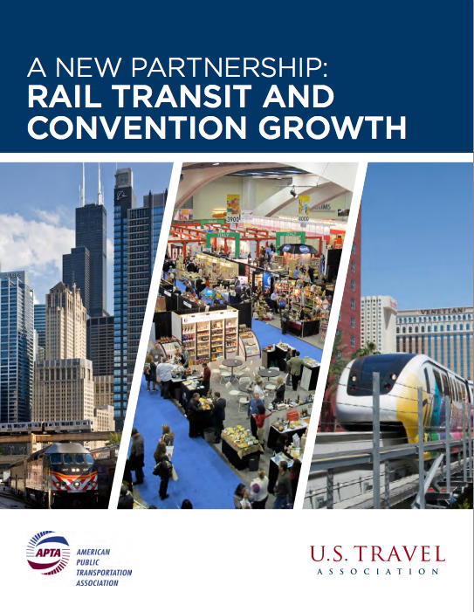
Notes:
So, we noted that a new generation prefers a variety of options, with transit near the top of their list of concerns. Research from the Urban Land Institute and RCLO, a real estate consultancy also shows that other generations care about mobility choice as well. In “A New Partnership: Rail Transit and Convention Growth” a paper we released with the US Travel Association, we noticed that preferences for business travel are being impacted by changing mobility habits as well.

Slide 17
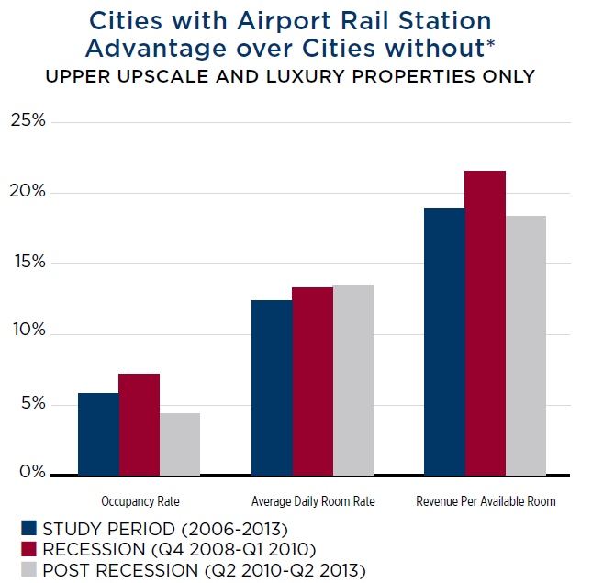
Convention Business Advantage
Notes:
The research showed that hotels, that focus on conventioneers, performed better in cities that have rail to their airports. These hotels had higher occ-u-pancy rates, and were able to charge—more--per room. Higher occupancy rates and more per room is a sign of a healthy convention business.

Slide 18
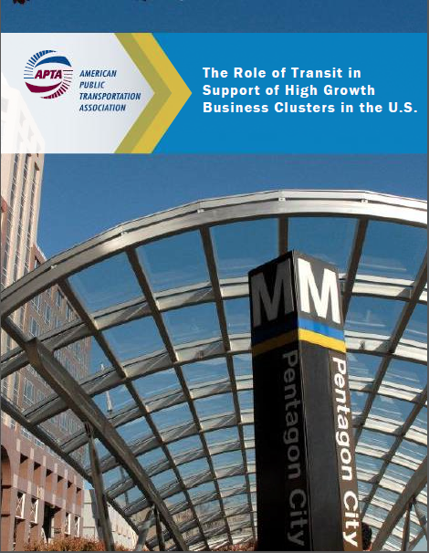
Notes:
So we learned that preferences are shifting towards communities with a variety of mobility options, we learned that those preferences are also having an impact on convention business. We also talked about the changing business location decisions of companies. In this recent report, “The Role of Transit in Support of High Growth Business Clusters in the U.S.” We measured the ability of communities to continue to grow, given that the clustering that typically happens with high tech firms can lead to congestion.

Slide 19
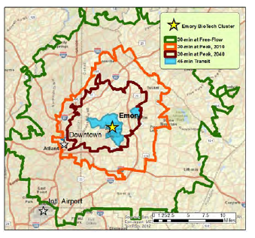
Congestion Chokes The Job Engine
Notes:
In our study we found that, the knowledge intensive industries that are driving job growth, can easily be choked by congestion. The reduced access to labor markets, as this graphic shows, can impact the ability of firms to compete, putting our communities and our nation as a whole at a disadvantage. In fact, due to the high-value clustering, siting new highways can be difficult, making transit the primary congestion relief option. We found that hundreds of thousands of jobs and tens of billions of GDP are at stake.

Slide 20
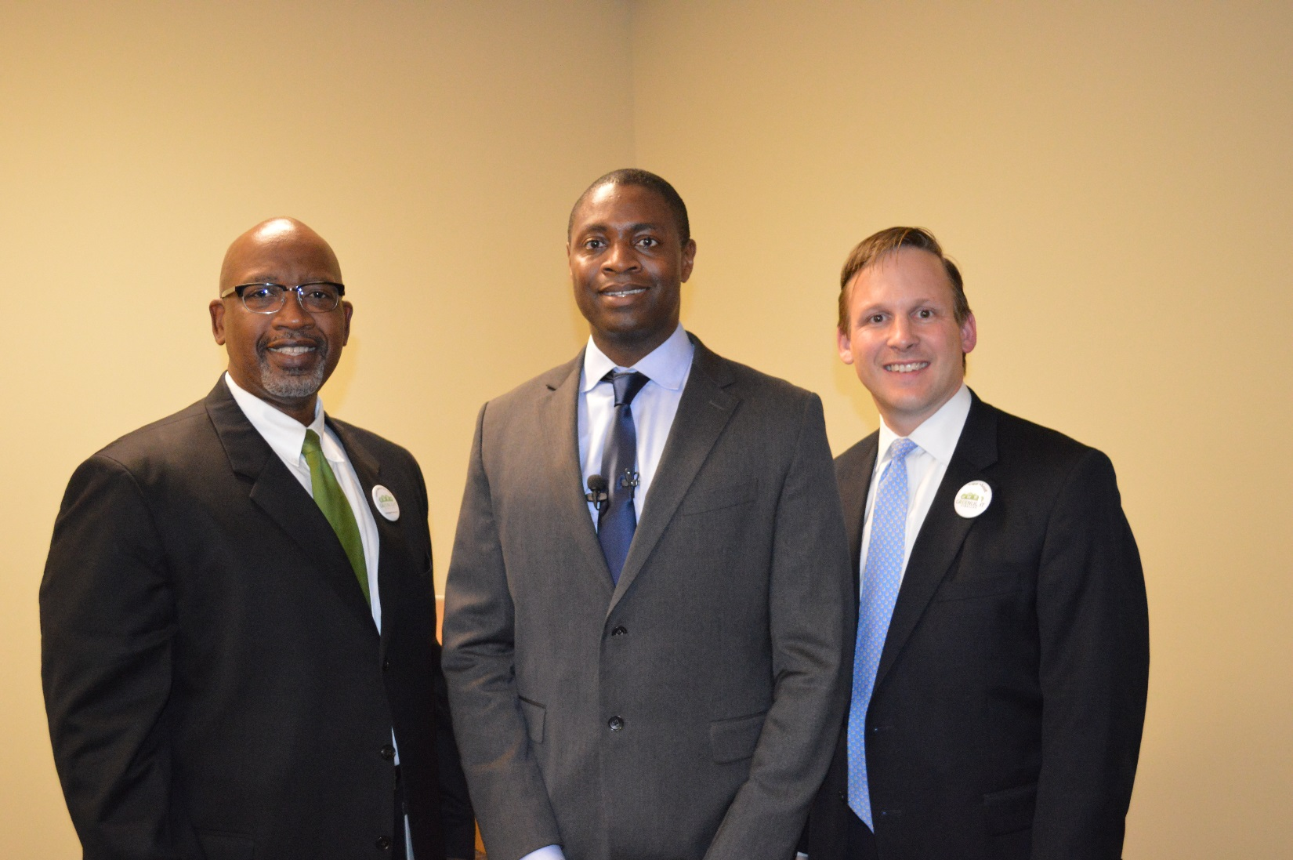
Pinellas Suncoast Transit Authority
Notes:
This research on our changing economy, and how its impacts our communities, and the relative importance of public transportation, can be used to impact your local campaigns.
This is me with Pinellas County Commissioner Ken Welch, and CEO of Pinellas Suncoast Transit Authority, Brad Miller. They invited APTA to present on our Millennials research. There was a packed crowd of supporters….

Slide 21

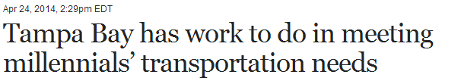


Pinellas Suncoast Transit Authority
Notes:
As well as significant press from the event. Holding events where public transportation research is presented, is a way to own the dialogue, convene your supporters, and provide your community with detailed information on a key topic. It can help refute much of the negative and erroneous information that is out there. A number of organizations in Washington, DC and around the nation can provide assistance.

Slide 22
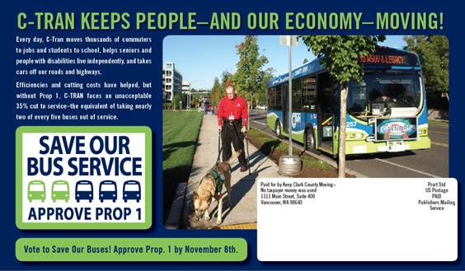
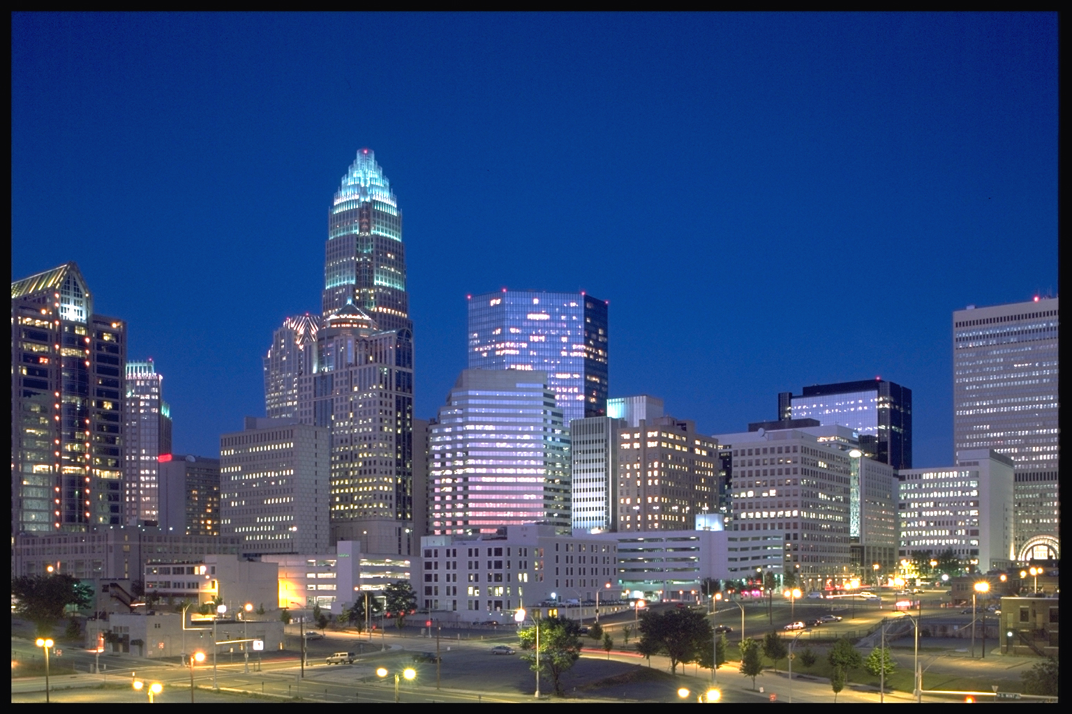
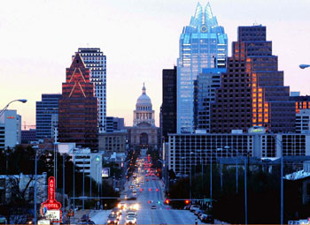

Stronger
Notes:
I would like to leave you with three takeaways:
Pragmatism—investment is about pragmatism, because it can increase the attractiveness of a community.
Job growth—our economy is changing, but communities can compete, even in a globalizing environment
Options Win—providing options for everyone including Millennials, is a winning strategy.
Communities that are willing to invest properly, can see outsized benefits:
Children stay or return
Communities can have grandmothers, fathers, and daughters all living in the same metropolitan areas because there are choices and opportunities for everyone—including job opportunities, which as I mentioned are increasingly tracking with employee location decisions.
Increasingly cities are choosing to create options that are attractive to everyone—whether people choose to drive, to take public transit or walk to pick up a carton of milk, each option is becoming viable. These communities are increasingly enjoying unique dividends. Research can help tell that story. With that I will conclude and I am happy to answer questions.

Slide 23
Darnell Grisby
Director, Policy Development and Research
dgrisby@apta.com
American Public Transportation Association
www.apta.com
Notes:
If you have any questions, please feel free to contact me. I would love to chat with you and assist you in anyway.
Thanks

Slide 24


The Member-led Campaign to Support Investment and Authorization
.

Slide 25

Marketing and Communications Committee and Legislative Committee Are Leading the Effort
Two Goals:
  To broaden support for and show value of public transportation in your community and throughout the country
  To create a favorable environment for increased investment with MAP 21 expiring in September 2014
.
Notes:
Today we are sharing the latest version of the creative and messaging plans to launch this effort at the APTA Legislative Conference on March 10. You will have an opportunity to see the final product at the Marketing/Communications Workshop “Lunch and Learn” session.

Slide 26

Research Underpins Messaging
Started at 2013 Marketing and Communications Workshop
Heart + Mind Strategies conducted both support and message research testing with public influencers around the country
  1,000 general public influencers surveyed on support and messages earlier this year
  Cross section of Democrats, Republicans and Independents
Most influencers are favorable towards public transportation, while also in support of tax dollars going towards PT improvement and increasing current spending levels

Slide 27
Top 3 Priorities From APTA Marketing & Communications Experts
Priority 1: Modern public transportation is vital to a growing community
76%
Priority 2: Build public trust in transportation as a valued partner
72%
Priority 3: Public transportation is a jobs creator and builds local economic impact
57%

Slide 28






Half are ‘Very Favorable’ Towards Public Transportation
Favorability Toward Method of Transportation
T
Public transportation | Driving your own car | Rail (subway, trolley) | Taking the bus
Mean →
6.7 | 7.5 |  | 7.7 | 6.7 |  | 6.4 | 7.9 |  | 5.9 | 6.0
GP | DC |  | GP | DC |  | GP | DC |  | GP | DC
Base: General Population (N=420), DC Influencer Audience (N=143)
Q205.There are different ways people get around in your community. I’d like you to think about the importance and impact that each has in the area where you live and for each method, please use a scale from 0 to 10, where “0” means you feel NOT AT ALL FAVORABLE toward that method of transportation and “10” means you feel EXTREMELY FAVORABLE toward that method of transportation. Your answer does not necessarily reflect the mode of travel you use.
28

Slide 29


Support for Tax Dollars Going Towards Improvement/Expansion is Strong
in LOCAL Community
Around the Country
(asked DC Influencers only)
Tax Dollars toward Expansion and Improvement of
Public Transportation...
Base: General Population (N=420), DC Influencer Audience (N=143)
Q226. Do you support or oppose the allocation of your local tax dollars toward the expansion and improvement of public transportation services in your LOCAL community?
Base: DC Influencers Only (N=143)
Q225. Do you support or oppose the allocation of tax dollars toward the expansion and improvement of public transportation services in communities around the country?

Slide 30
A Majority Believe that the Level of Spending Should be Increased
Level of Spending that Should Be Allocated for Improvement of Public Transportation Service and Access...
60%
77%
8%
5%
Base: General Population (n=420), DC Influencer Audience (N=143)
Q230. Thinking about your own local public transportation, what level of spending do you believe should be allocated for
the improvement of public transportation services and access for the local system where you live?
30

Slide 31
We Must Cut Through the Noise
Talk about public transportation in a compelling and relevant way that appeals to varying interests
Emphasize direct communication with policymakers, while also building strong advocate base
Take advantage of key moments in time to amplify messaging
Build a surround-sound effect through an integrated effort from APTA, local member systems and business members
.

Slide 32
Message Alignment
Research
PT benefits everyone
PT is vital to our community
Brand
Where PT goes, community grows
Allows modern communities to move forward
Advocacy
PT is vital to communities
Economic benefits
Local Systems
Our local system is vital to the growth of our community
Local economic benefits

Slide 33
Integrated Communications Plan
D.C. Policymakers and Local Influencers
D.C. and Targeted Advertising
Media Relations-National and Capitol Hill
Coalition Partners-National, DC and Local
APTA Member Advertising and PR Activities
Grassroots Advocacy- NAPTA and Voices for Public Transit
Social Media
Consistent Message

Slide 34



Ad Exposure Dramatically Increases Favorability Towards Public Transit
6.7 | 7.6 | ← Mean → | 7.5 | 8.0
Favorability Toward Public Transportation
+13
+14
GP
DC
Net change in 8-10 favorability
Base: General Population (n=420), DC Influencer Audience (N=143)
Q505 [PRE Q205]. Now, after reviewing the print ads, how favorable are you toward public transportation, using a scale from 0 to 10, where “0” means you feel NOT AT ALL FAVORABLE toward public transportation and “10” means you feel EXTREMELY FAVORABLE toward public transportation? You can use any number from 0 to 10.
34

Slide 35
Support of Increased Spending Strengthens Substantially with Ad Exposure
Level of Spending that Should Be Allocated for Improvement of Public Transportation Service and Access...
60%
67%
+7
77%
82%
+5
8%
6%
5%
5%
GP
DC
Net change in spending
Base: General Population (N=420), DC Influencer Audience (N=143)
Q530 [PRE Q230]. Earlier you indicated that you would [response from Q230] for the improvement of public transportation services and access for the local system where you live. Based on what you have reviewed today, what level of spending do you believe should be allocated for the improvement of public transportation services and access for the local system where you live?
35

Slide 36

The Public Transportation Brand
Brand value over transactional value
Versatile
Forward-looking
Modern
Aspirational

Slide 37
Three Core Campaign Messages
Public transportation powers community growth. It drives economic development and revitalizes neighborhoods.
With Americans increasingly favoring public transit-centric cities and towns, public transportation is even more vital to growing communities today.
With demand for public transit rising and our nation’s infrastructure aging, we need to increase investment in public transportation at the local, state and federal levels.
.

Slide 38
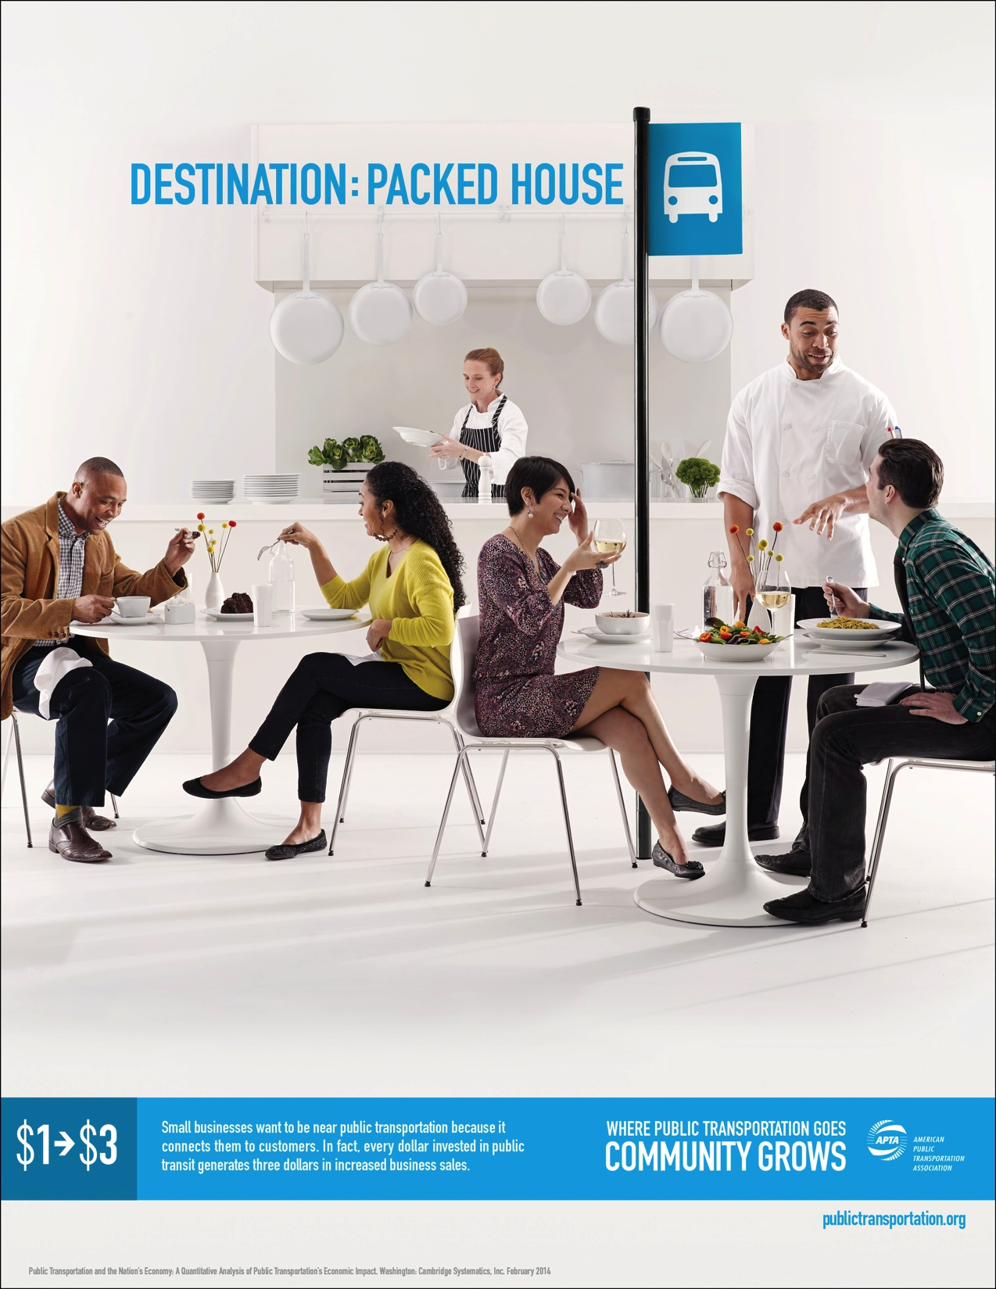
Print:
Packed House

Slide 39
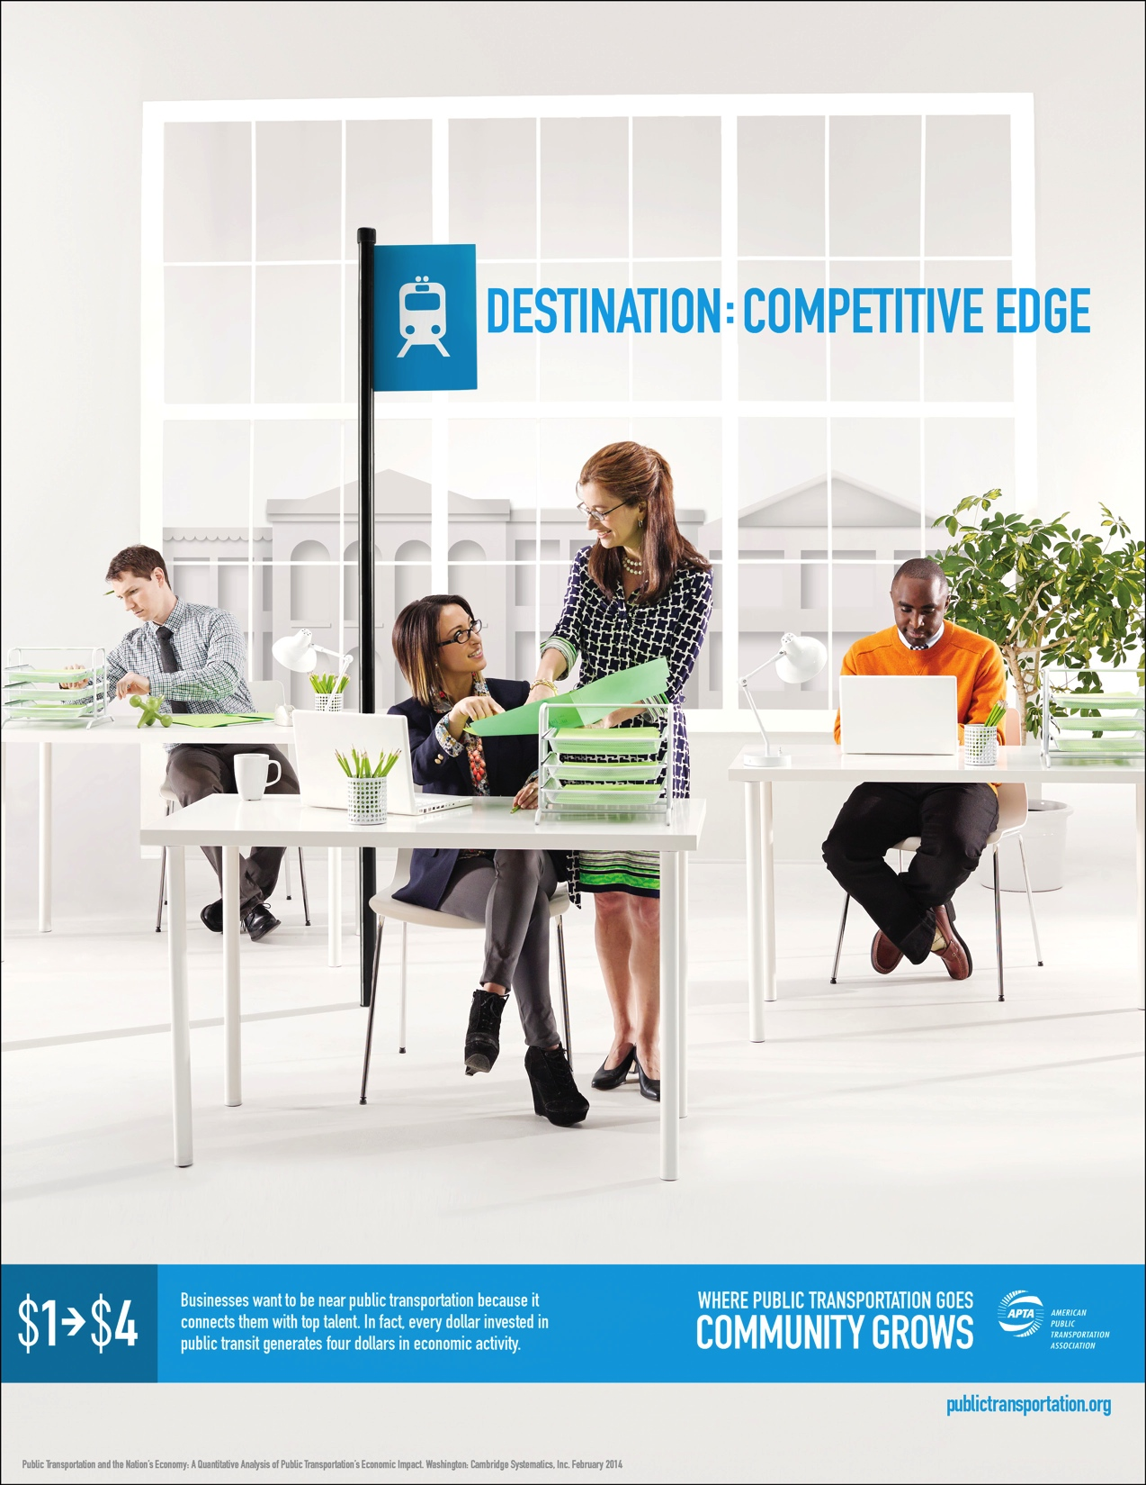
Print:
Competitive Edge

Slide 40
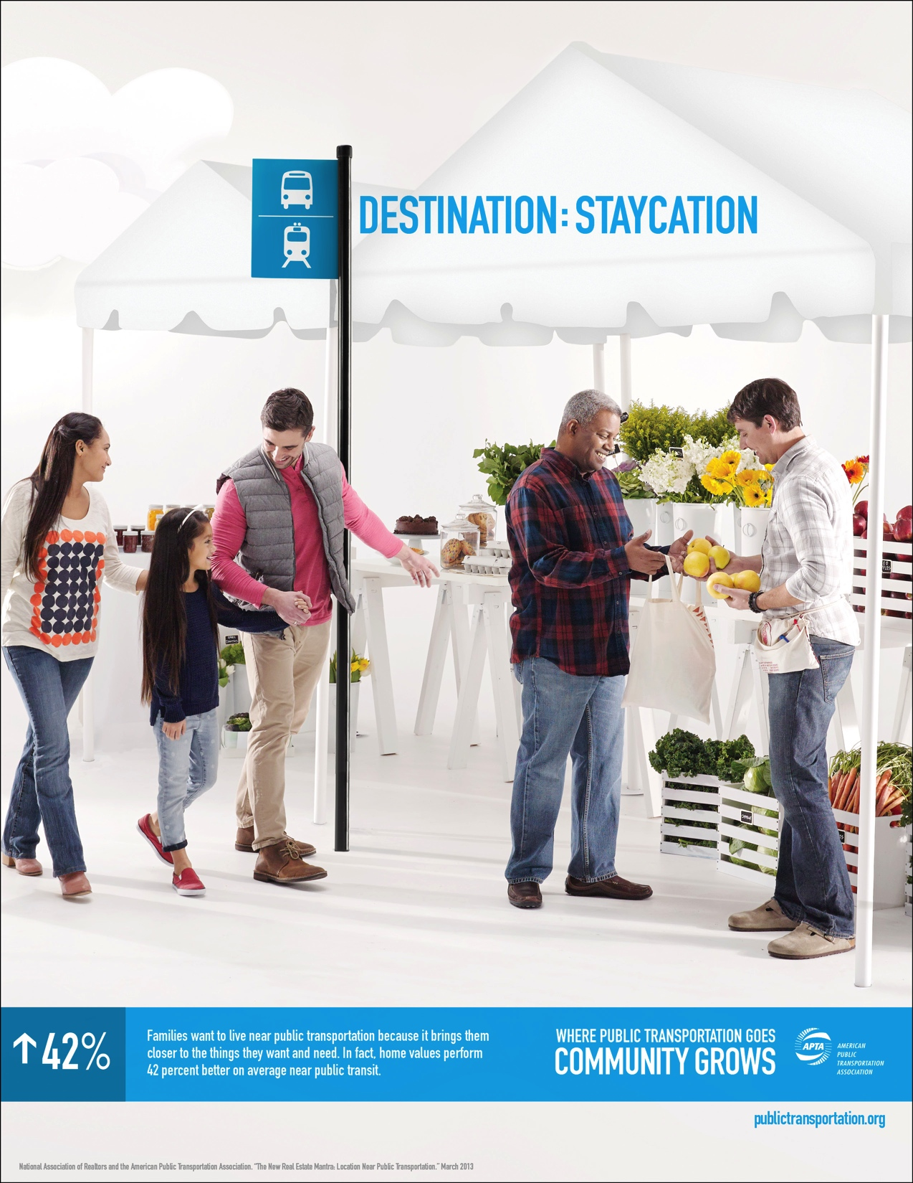
Print:
Staycation

Slide 41
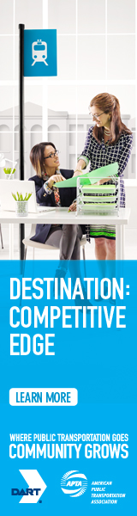
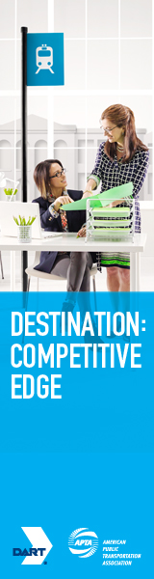
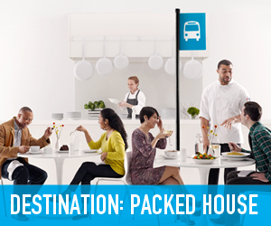
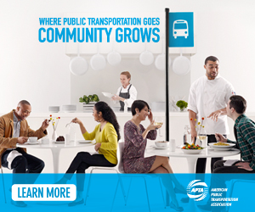


Online
Skyscraper (160x600)
Box (300x250)
Leaderboard (728x90)
41

Slide 42
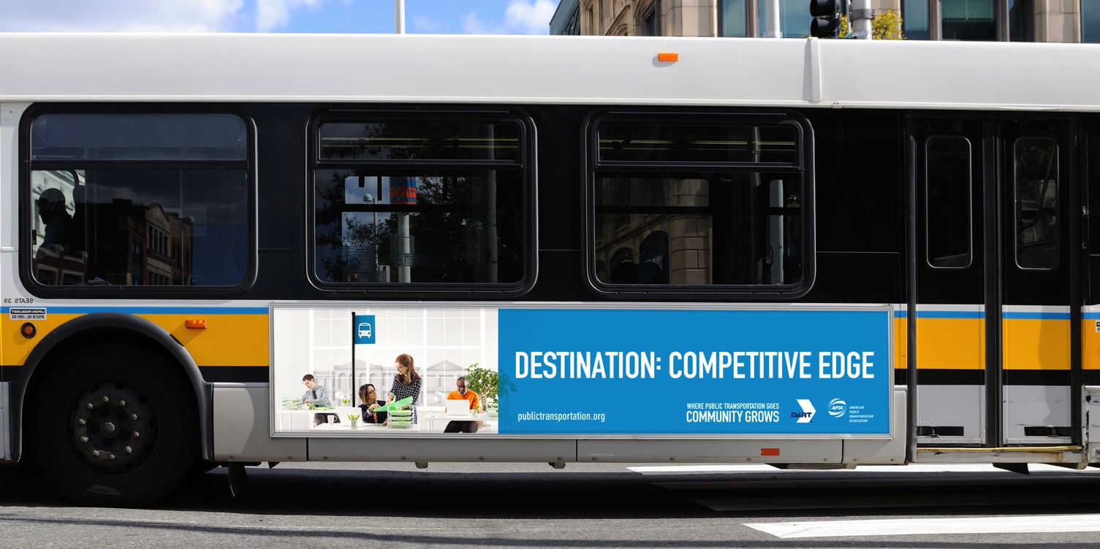
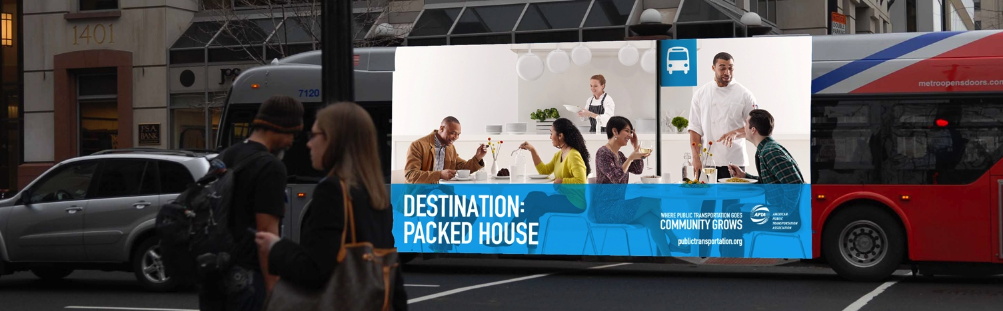
Outdoor
Bus Kings
Super Bus Kings
42

Slide 43
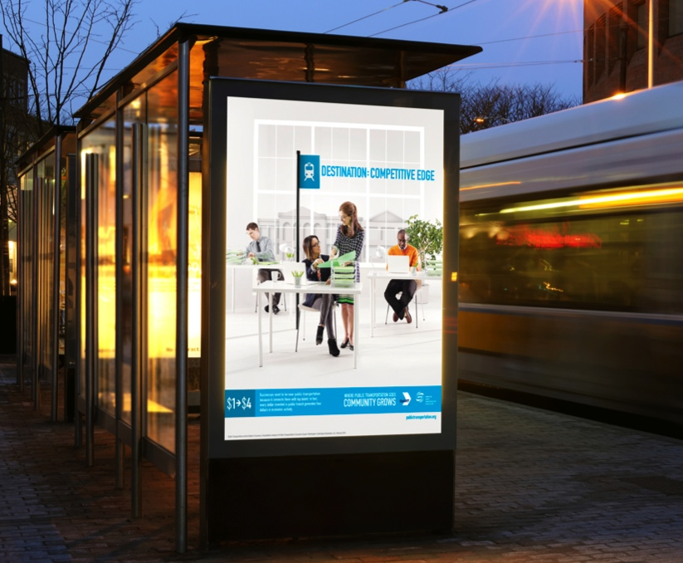
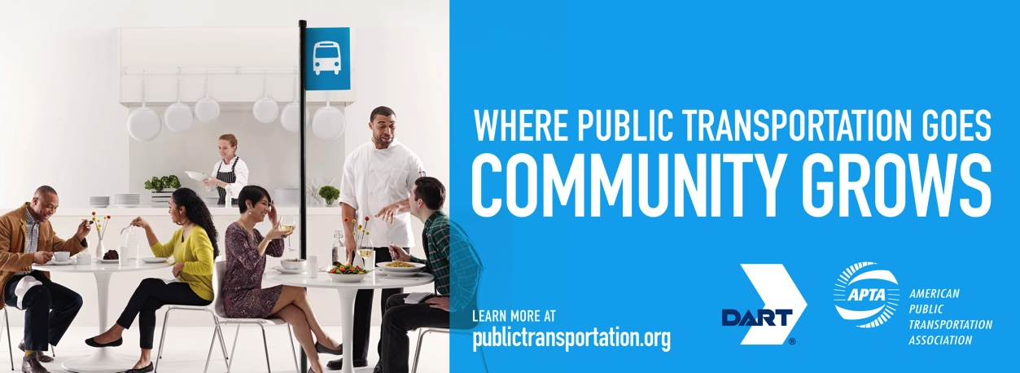
Outdoor
Bus Shelters
Bus Interiors
43

Slide 44

Ads Are Customizable
Ads are customizable: Local agencies have the ability to include system logos, local messaging and relevant blades
Locked InDesign files available: To allow for logo customization of up to two logos, as well as local copy and fact changes
How to access:
  Visit the member section of apta.com to see more of the ads
  Email mwilliams@apta.com to obtain customizable design files

Slide 45
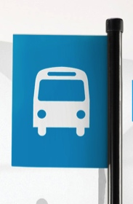

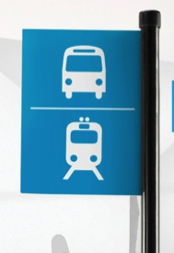
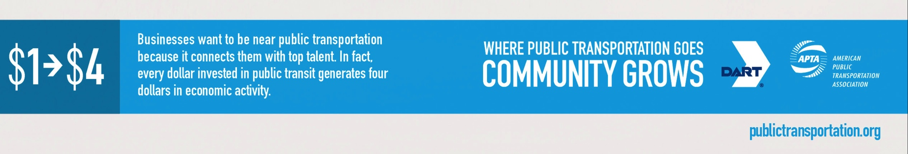
What’s Customizable?
Blade: Bus/Train/Both
(depends on system)
Copy: Localize
(Include city name/local facts)
Logos: Up to 2
(Agency with APTA or Partner)
Photography is for display only – not for publication.

Slide 46
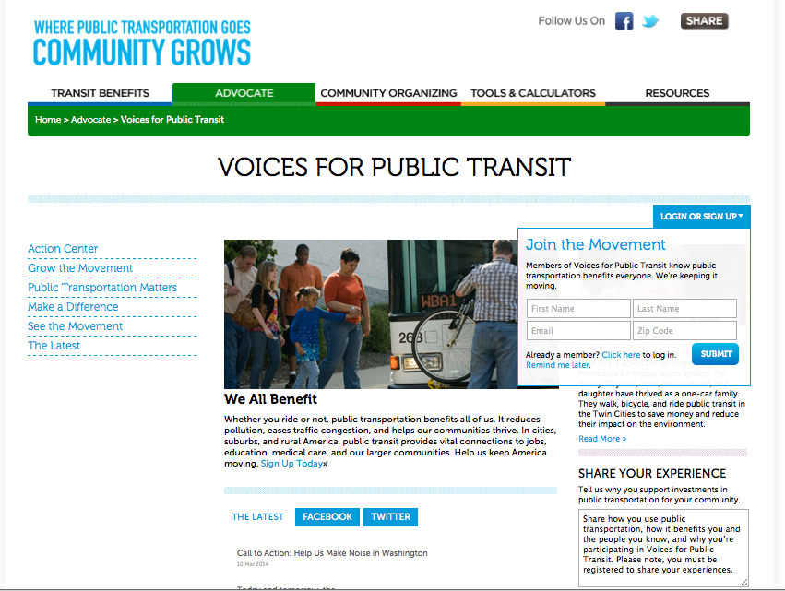
Voices for public Transit: A Grassroots Movement
Build a national base of bi-partisan grassroots support for comprehensive public transportation and infrastructure investment.
  Increase understanding of public transportation issues;
  Build trust and cultivate long-term advocate commitment through ongoing education and engagement;
  Create a strong advocacy foundation upon which to build.

Slide 47
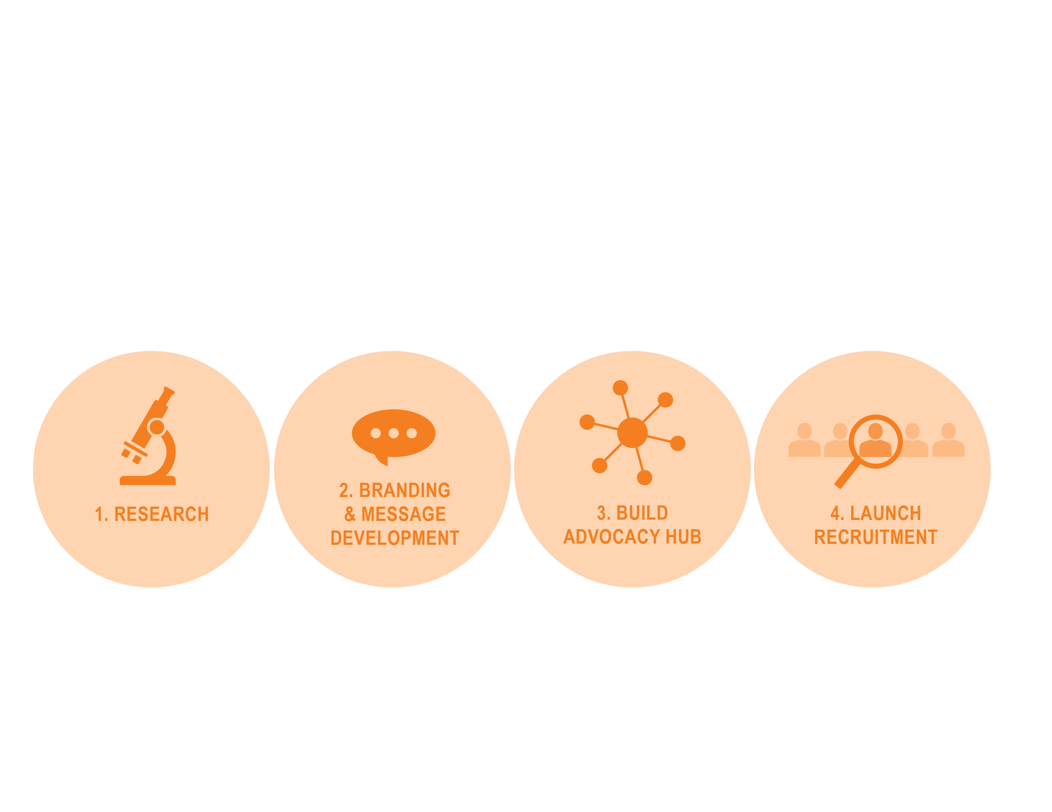
Steps to Build Voices for Public Transit
Campaign design required collaboration between multiple parties: APTA, NAPTA and Heart & Mind Strategies

Slide 48

Growing Digital Advocacy
Promote Voices for Public Transit to industry stakeholders
  Emails to managers and employees
  Promote VPT via internal newsletters, intranet sites, social media posts
  Member “toolkit” communications can make it easy
Promote Voices for Public Transit to consumers
  A vehicle to learn more
  Emails to consumer databases
  Highlight VPT in select consumer-facing advertising and PR initiatives
  Promote VPT on public website and social media properties

Slide 49

Working Together, We Can Create a National Movement
Advertising
Media relations
Social media – Facebook: publictransportation; Twitter: APTA_transit
Send us stories of public transportation contributing to economic/community growth
Legislative outreach to Congress members and staff
Work with local partners and advocates
Promote Voices for Public Transit – use #voicesfortransit, #transitgrowscommunities

Slide 50
Working Together, We Can Create a National Movement
Integrate the “Community Grows” Message Into your PR, Marketing and Legislative Messages
  Issue Press Releases that Tie to Message
  Organize Events Around the Message
  Release Reports that Tie to Message
  Write and Place Op-Eds (APTA will provide)
  Develop a Face Sheet with Examples
  Works with your Government Affairs Colleagues to Integrate Message in Legislative Materials
  Send APTA your stories of public transit contributing to economic/community growth

Slide 51
Working Together, We Can Create a National Movement
  Branding and Advertising
    Purchase and Place Advertising locally
    Place Ads on Your Vehicles, Bus Shelters, At Stations
    Place Ads on Website
    Work with other Systems and to Develop a Regional Campaign
    Ask Local Partners in Your Community to Sponsor Ads and Campaign

Slide 52
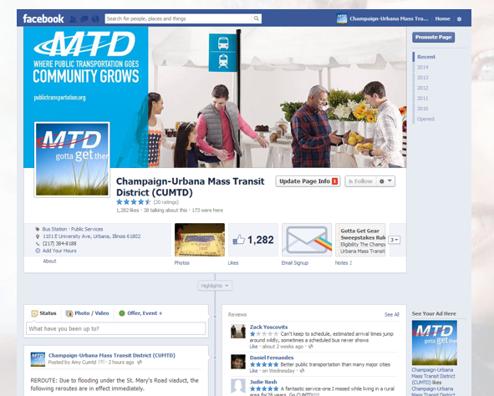
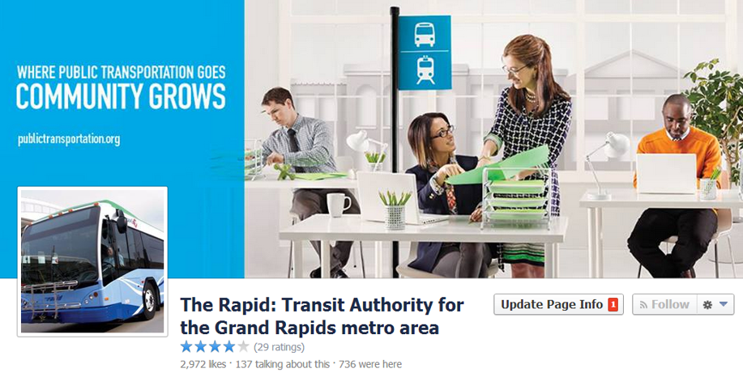
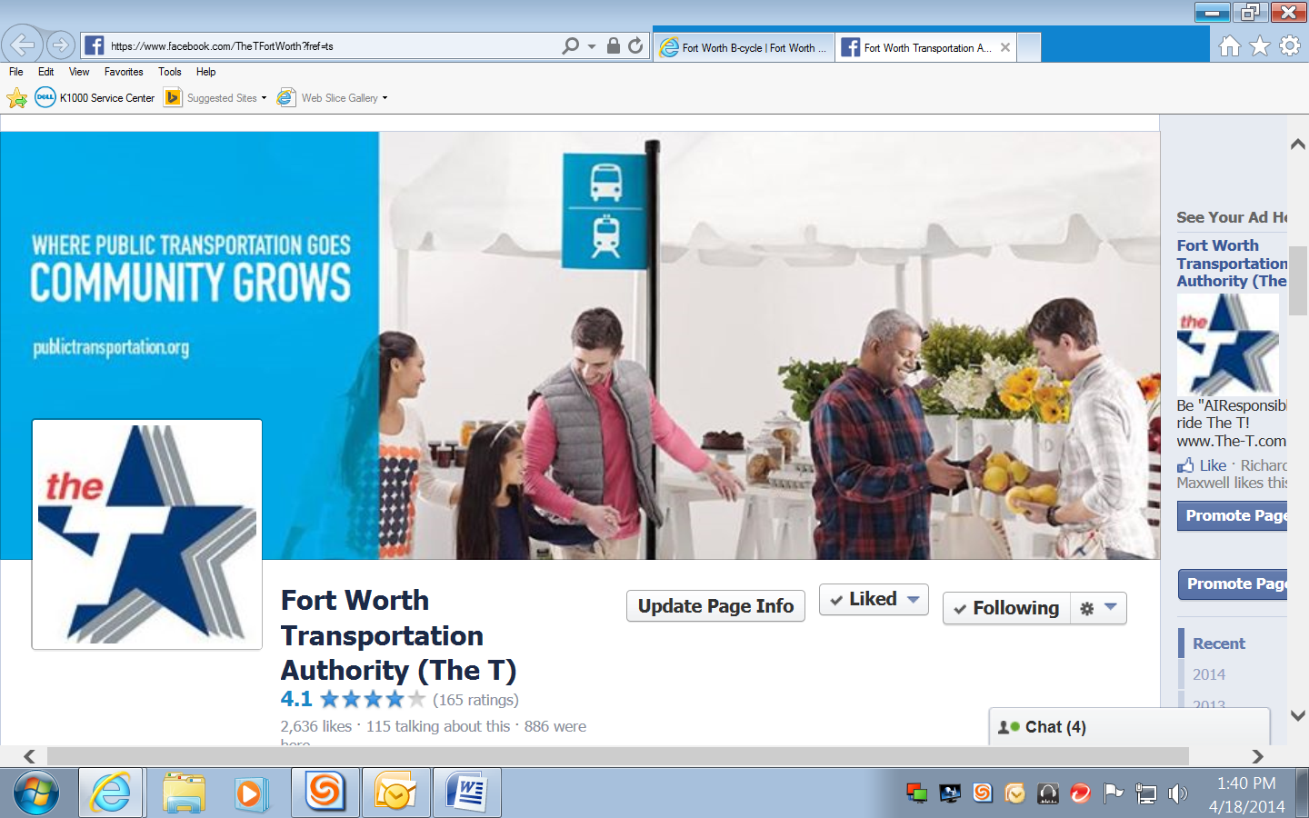
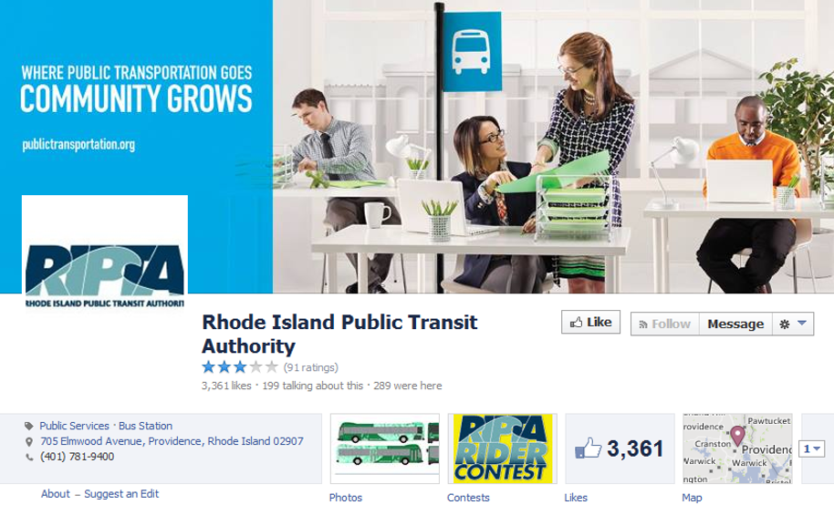
Local Execution: Facebook

Slide 53
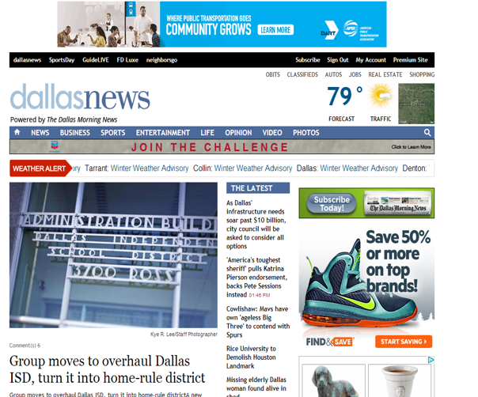
Local Execution: Online Ads

Slide 54
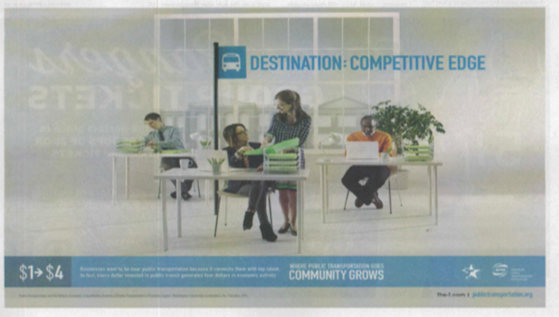
Local Execution: Print Ads

Slide 55
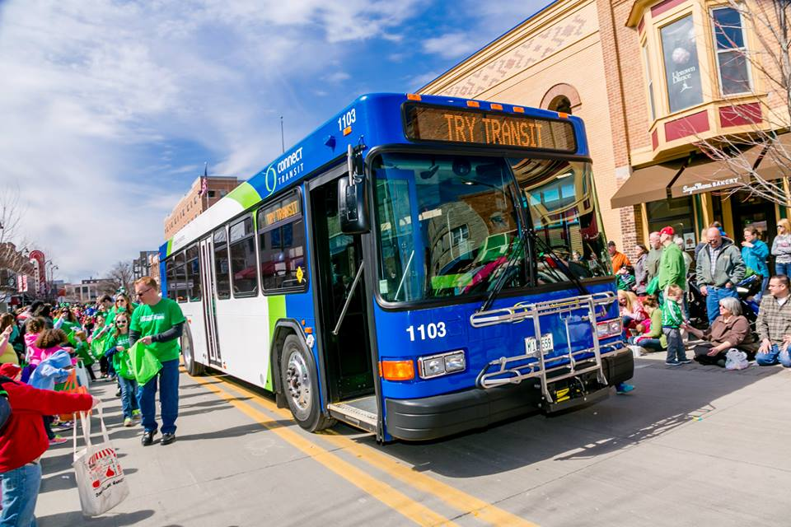
Local Execution: Special Events

Slide 56
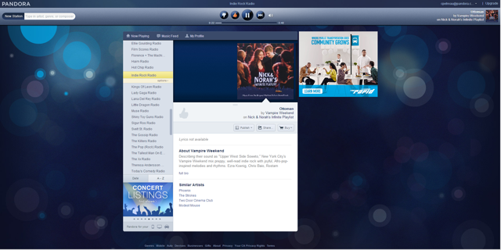
Local Execution: Pandora Ads

Slide 57
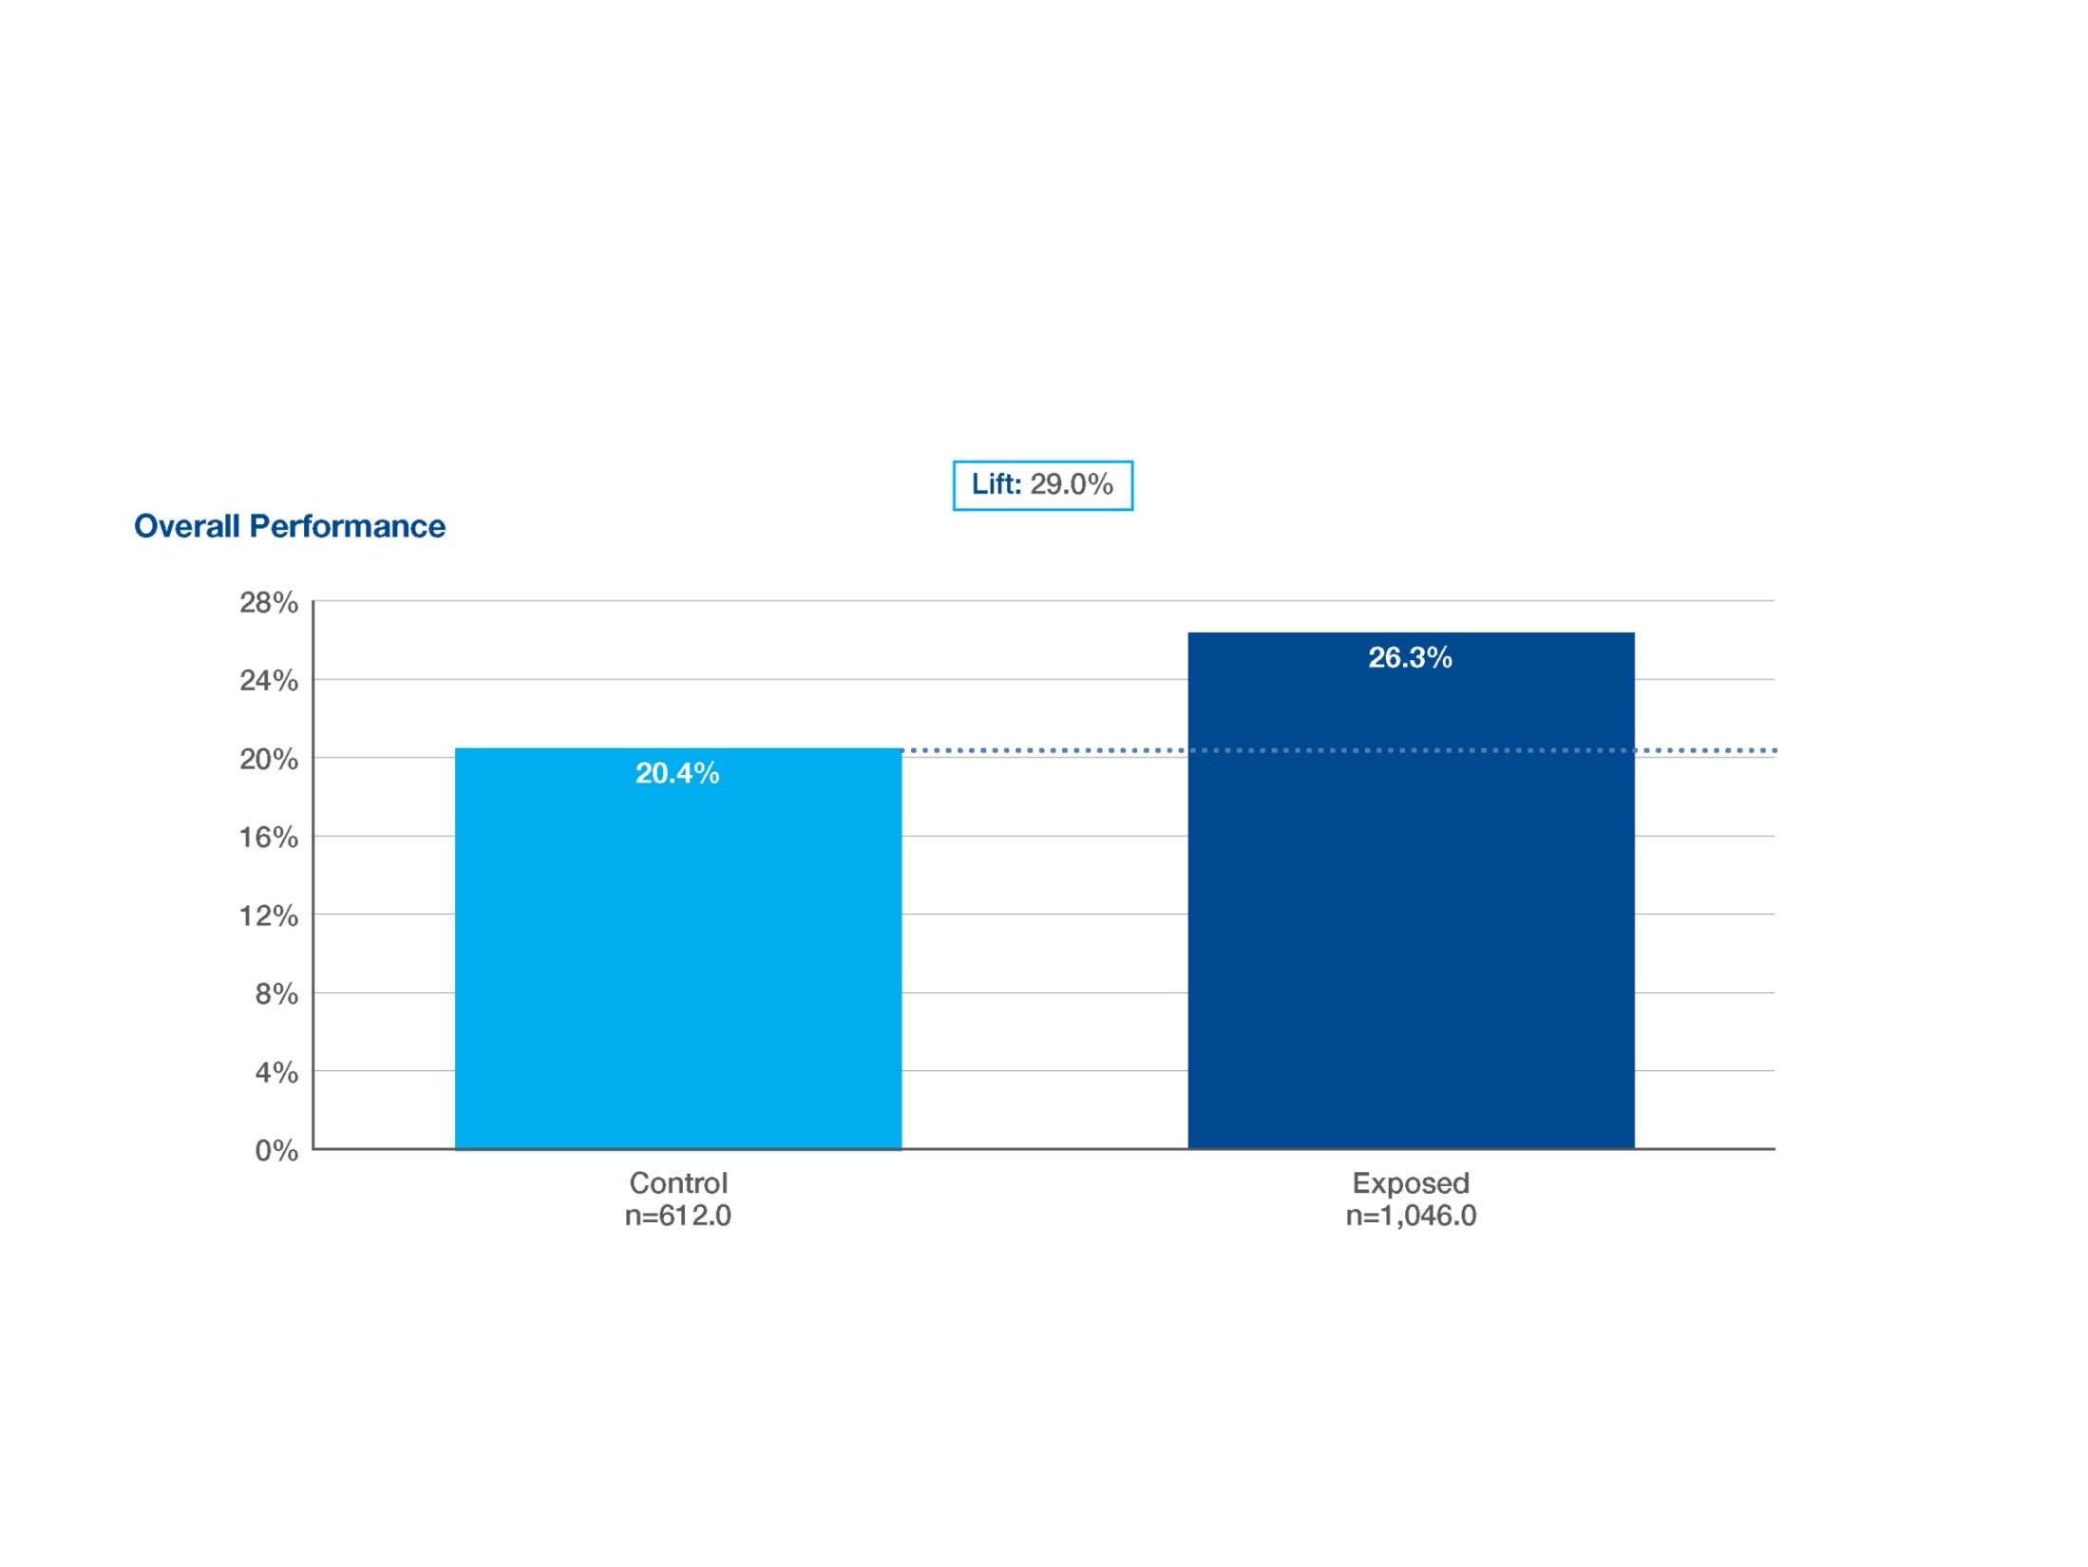
The “Community Grows” Message is Working!
29% increase in brand awareness, comparing those who saw the ads to those who did not
  17 Percentage points higher than industry norm
Cite: Nielsen/Vizu Study, March-April 2014

Slide 58
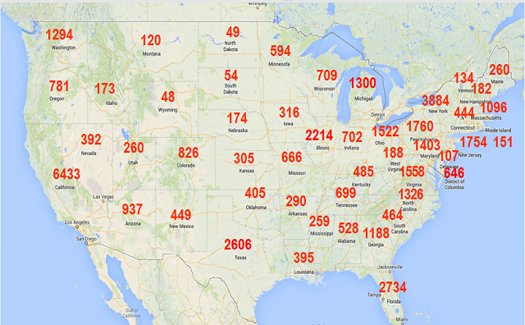
Voices for public transit performance
51,831+ advocates joined the community
23,763,786+ Display impressions served
169,143+ Facebook likes

Slide 59
Questions?
Ashley Robbins
Policy Manager, CFTE
arobbins@cfte.org
@cftenews
www.cfte.org
Thanks to our cosponsor

